Slide 1
crowd•noise
sample everything alongside your friends
miles aguilar, honors topics

Slide 2
content
1
backstory, sampling
2
concept
3
purpose
4
audience
5
demo
6
different?

Slide 3
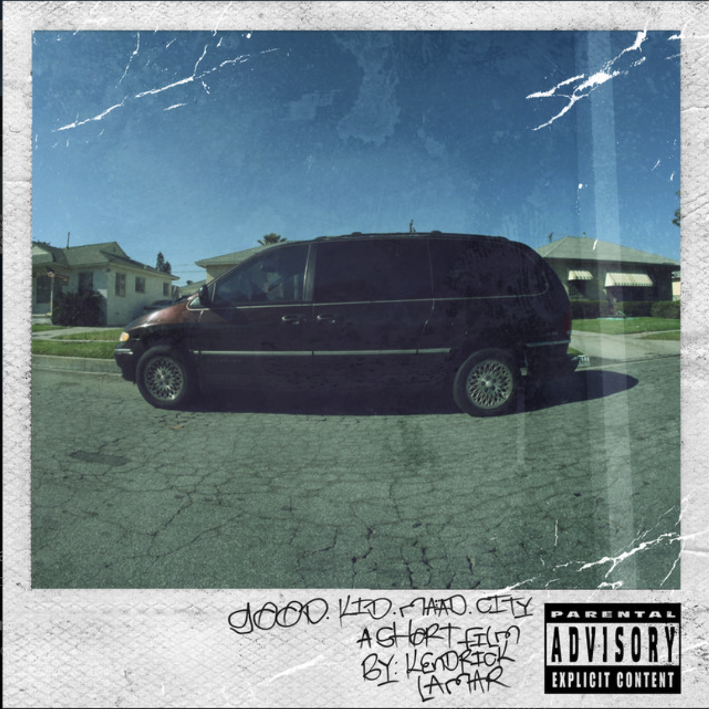
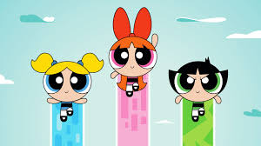
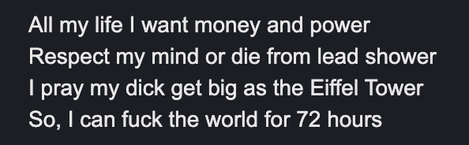
backstory
backstreet freestyle

Slide 4
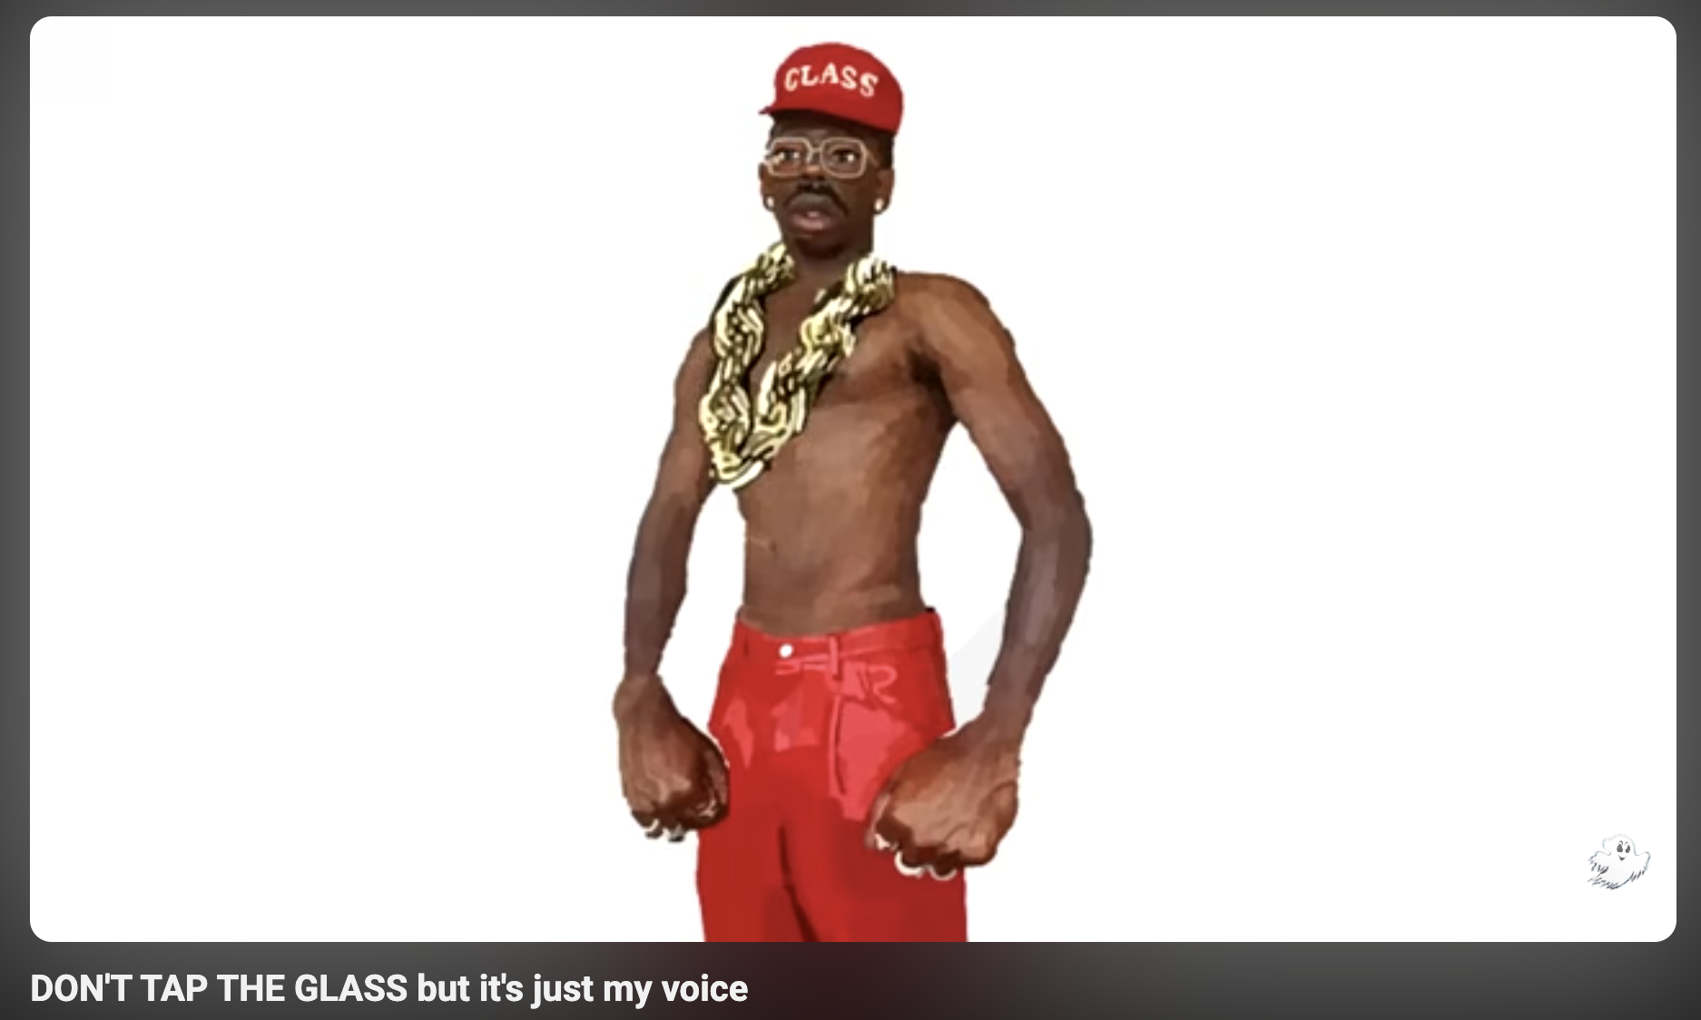

Slide 5
concept
crowd·noise is a community-based, gamified music production app where groups of friends recreate their fav songs using tiny recordings captured from themselves + their environment. you transform those clips with an in‑app sound changer, and layer them into a remake. at any point, you can rewatch the original video for a sample to see how far a sound came

Slide 6
purpose
make music production accessible
make it transparent
make it fun
make it collaborative
make it collectible (you’ll see)
a little of everything for everyone

Slide 7
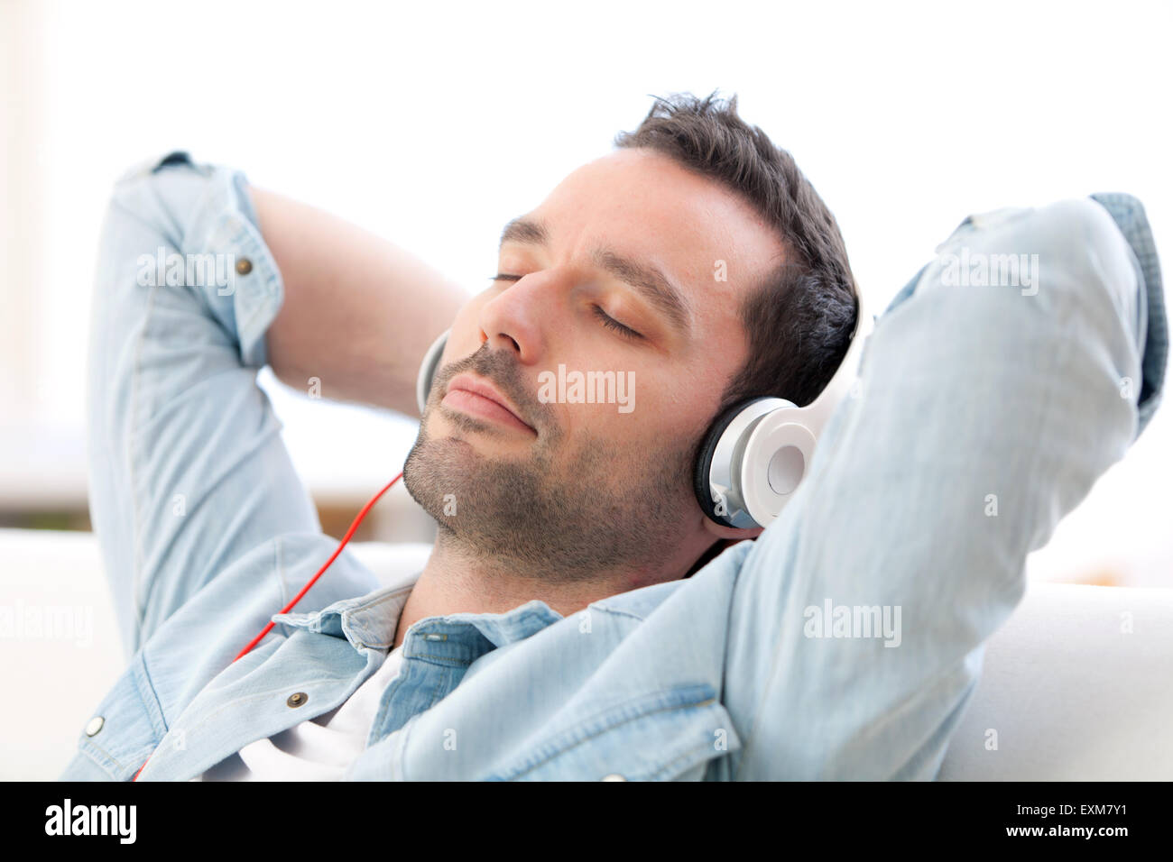
audience

Slide 8
ok so, how does it work?
Notes:
work in UCLA anecdote about presenting

Slide 9
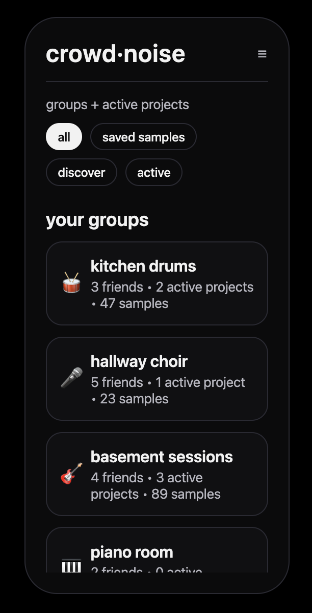

Slide 10
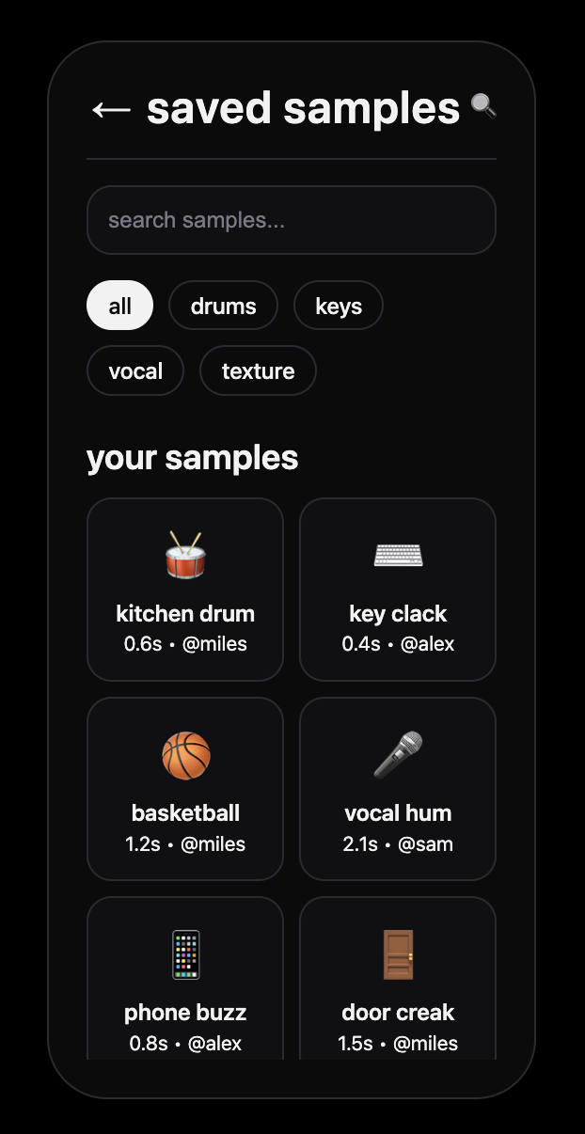

Slide 11
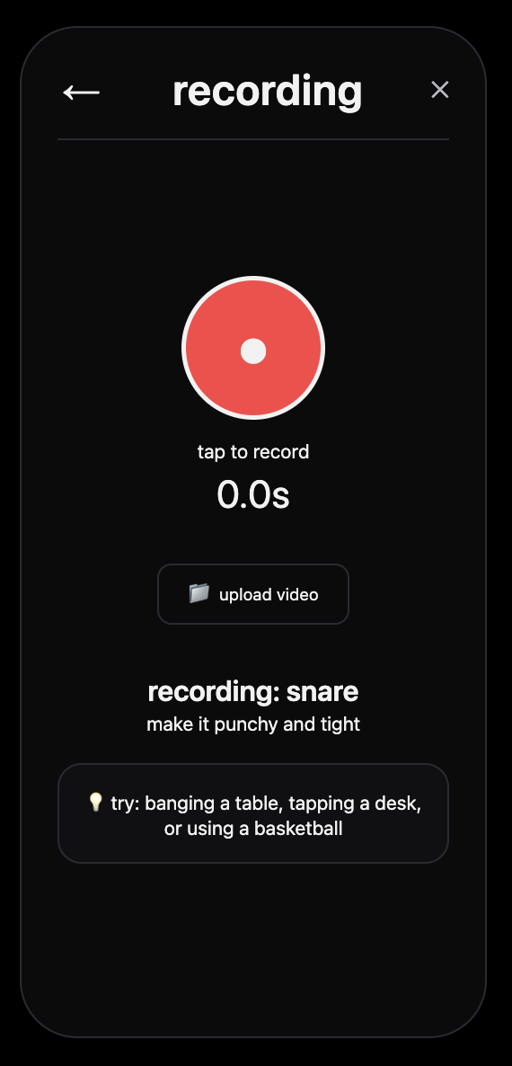

Slide 12
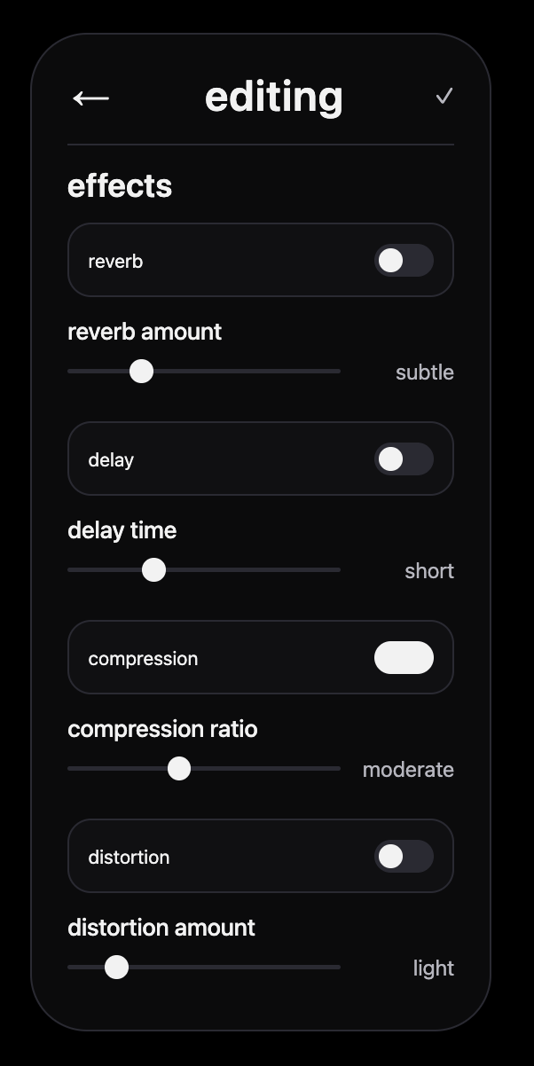
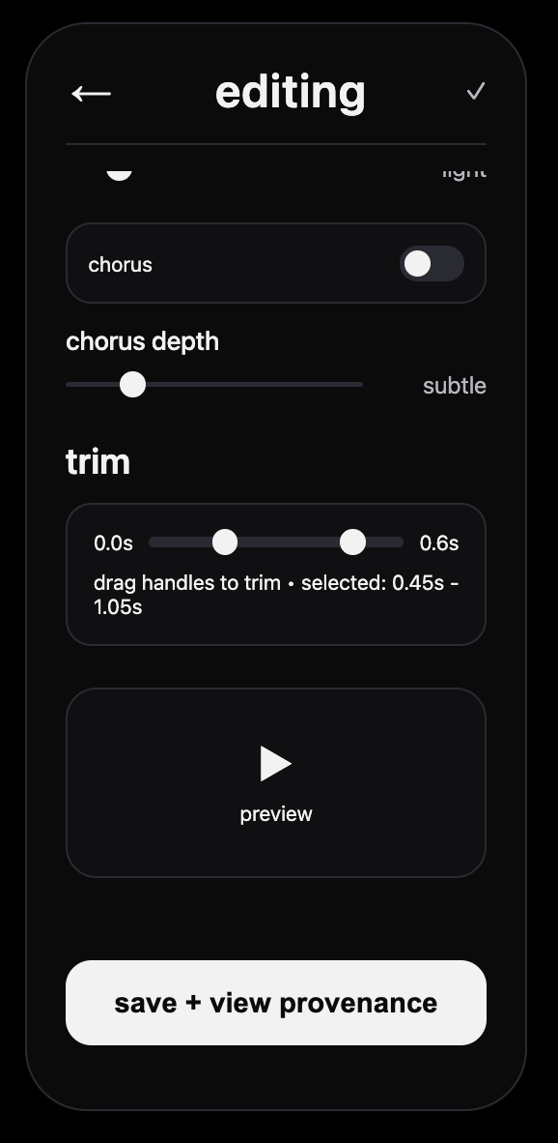
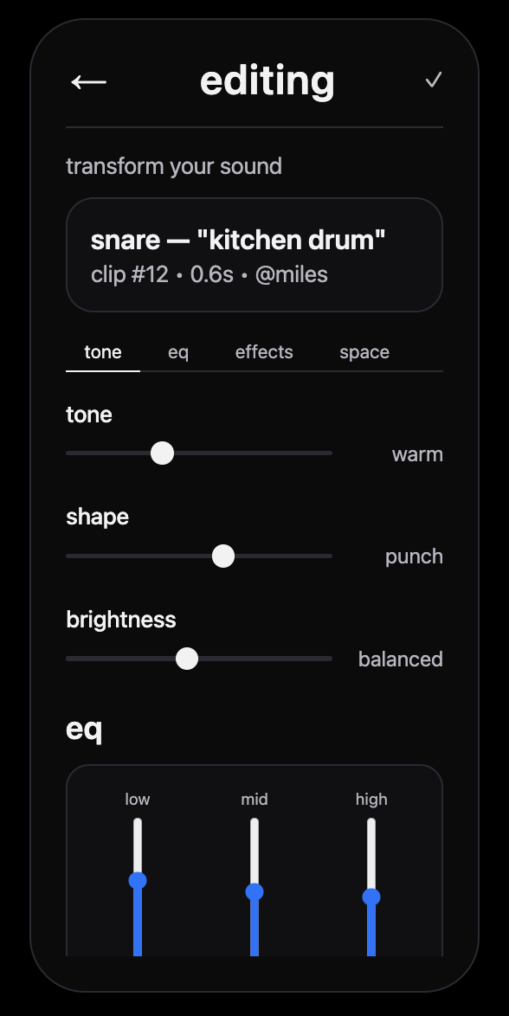

Slide 13
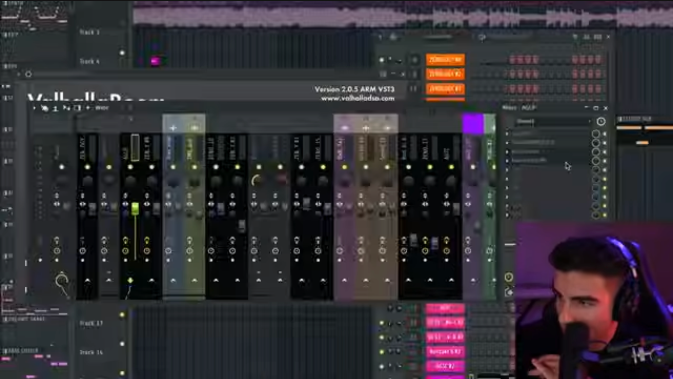

Slide 14
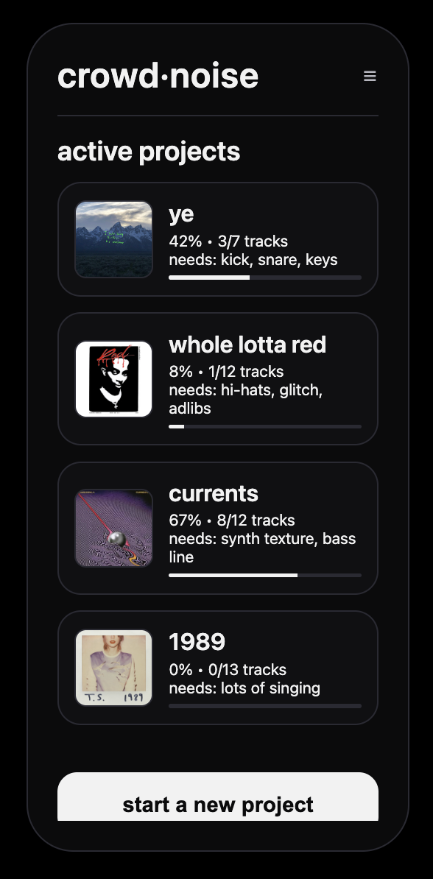

Slide 15
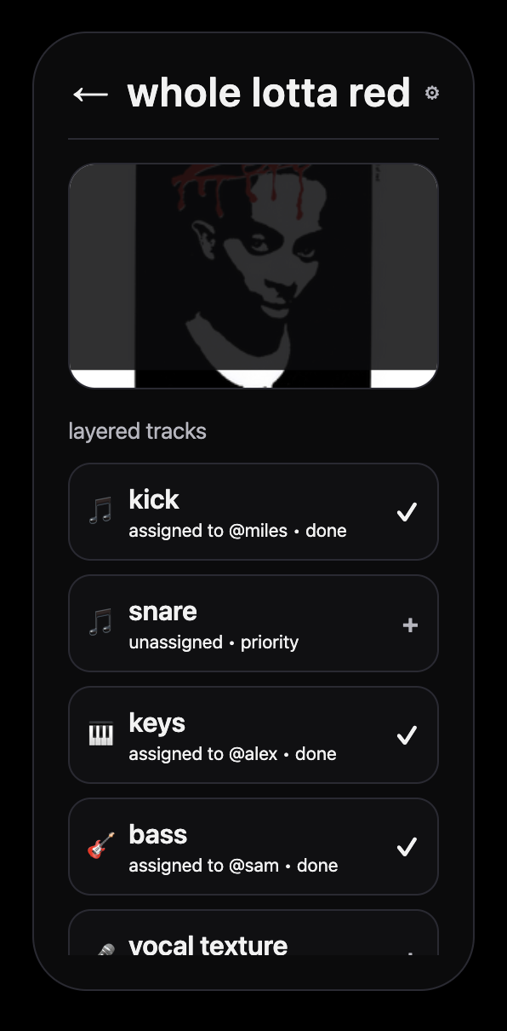
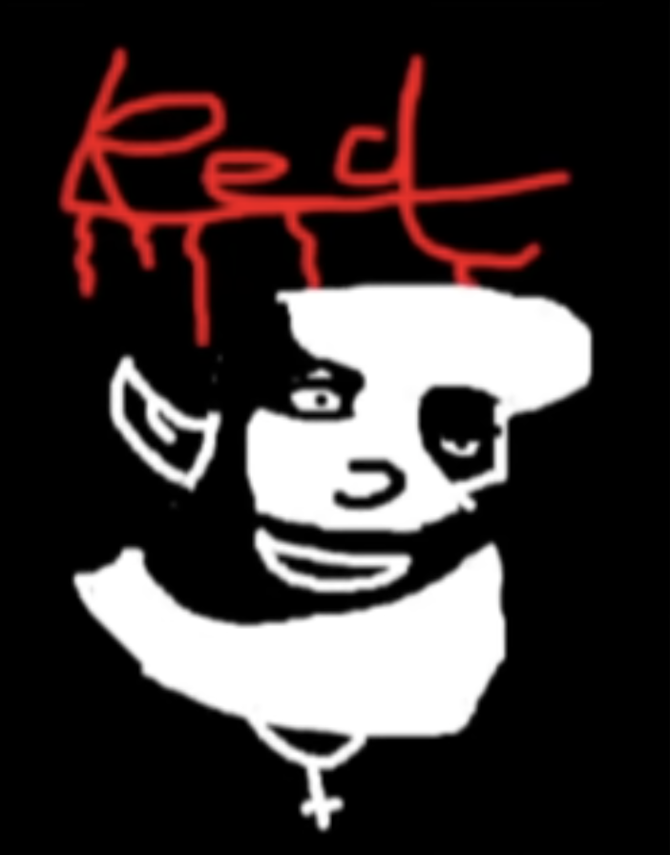
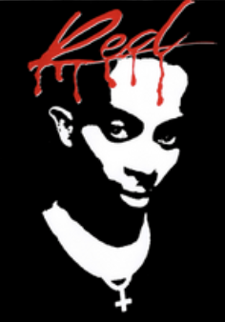
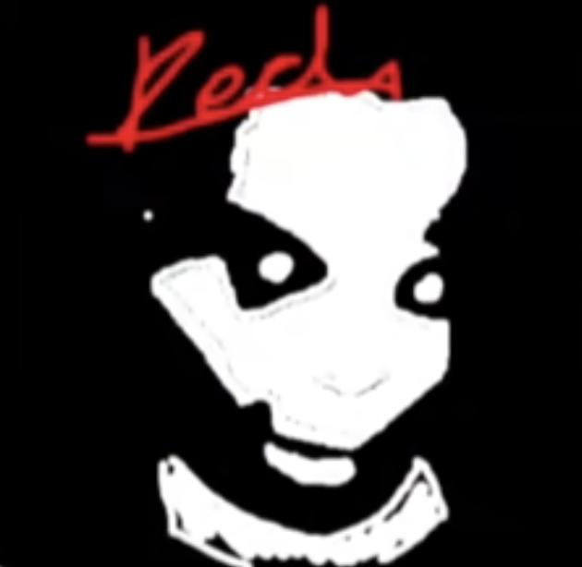
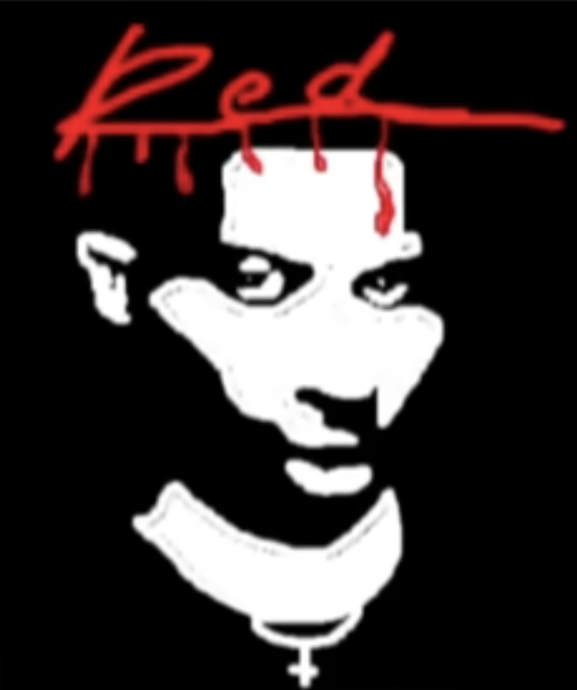
1/12 tracks lmao

Slide 16
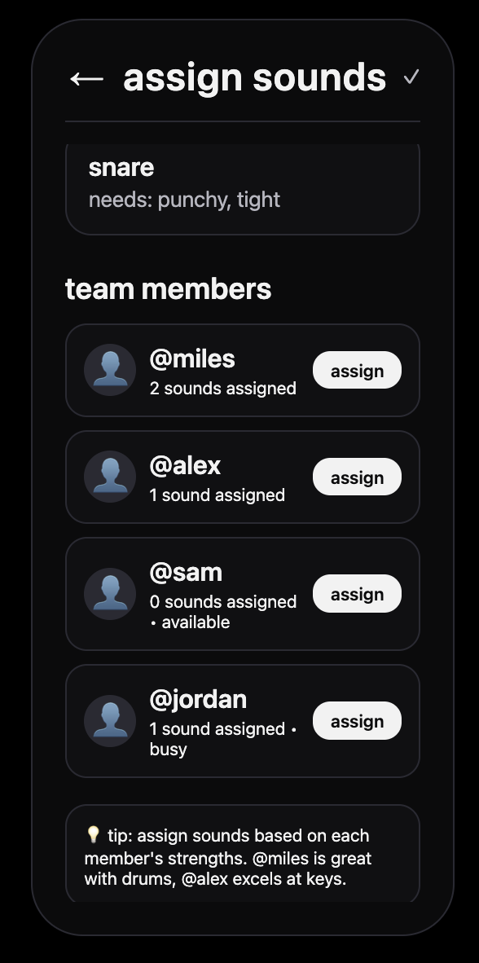

Slide 17
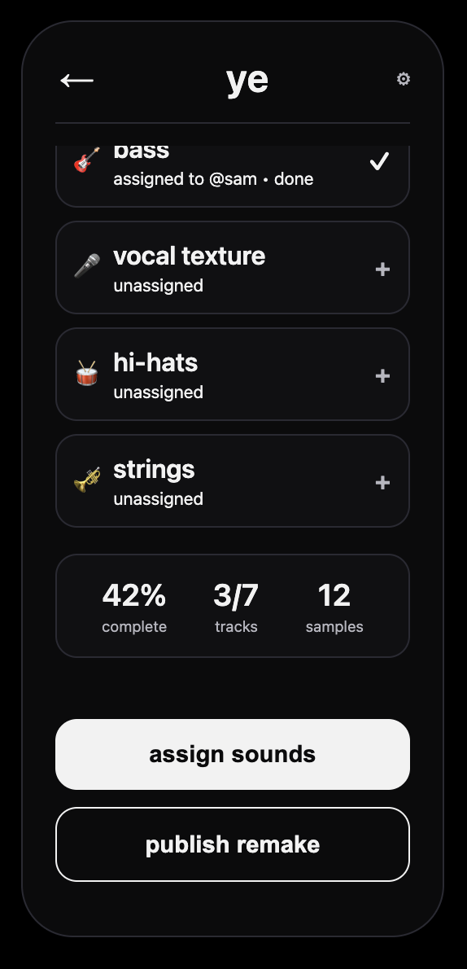
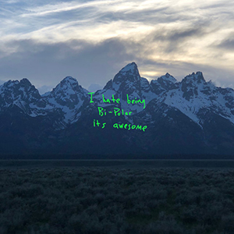

Slide 18
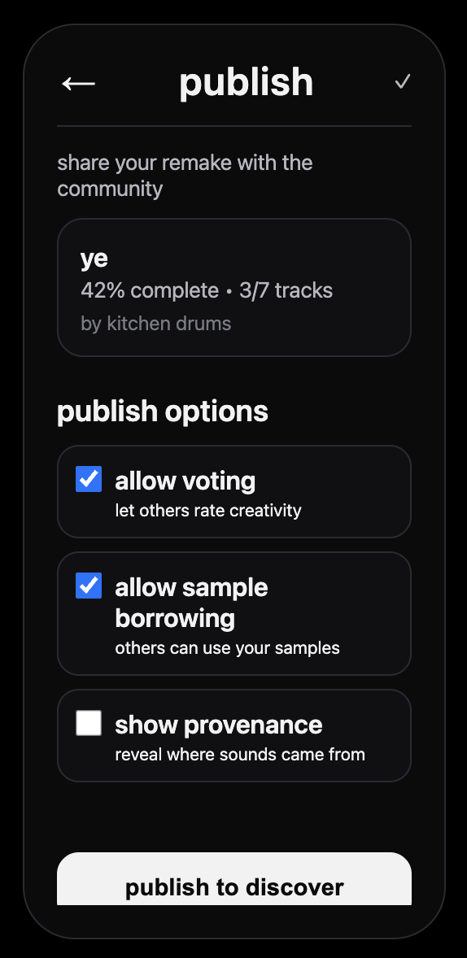

Slide 19
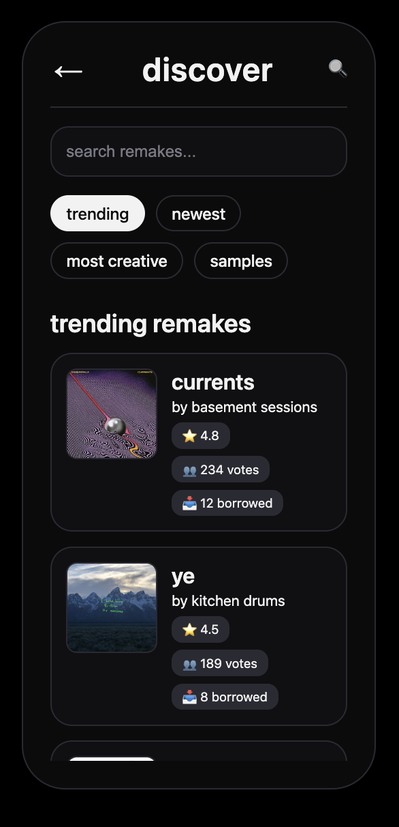

Slide 20
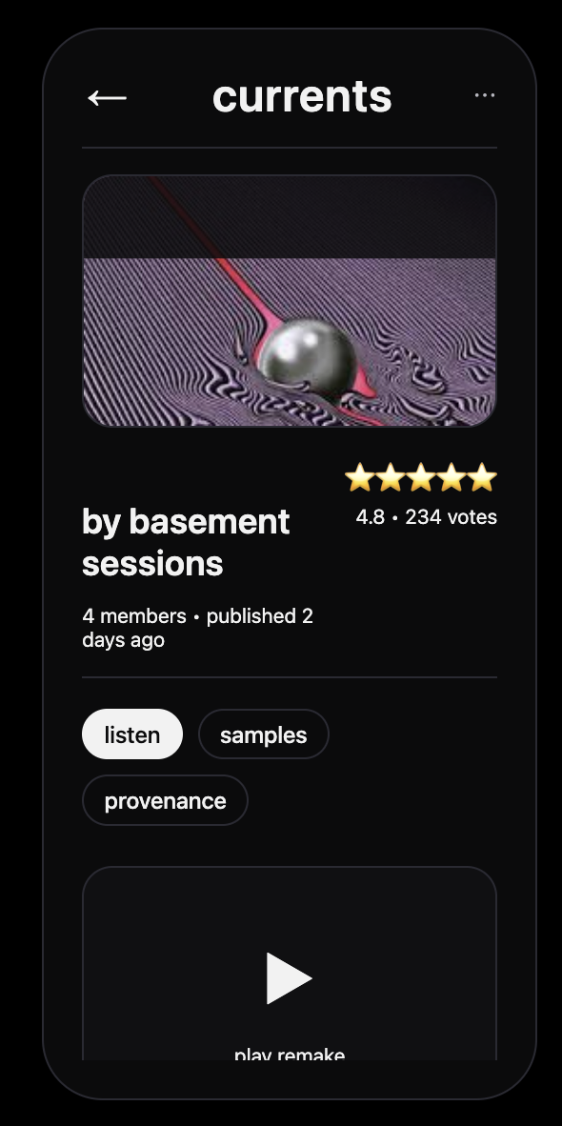

Slide 21
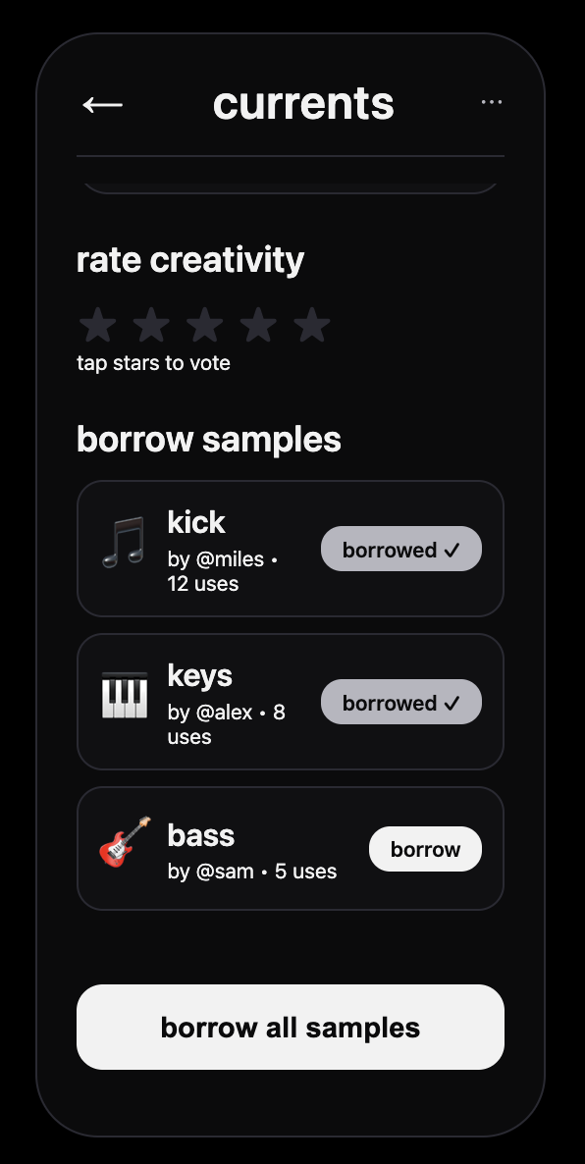

Slide 22
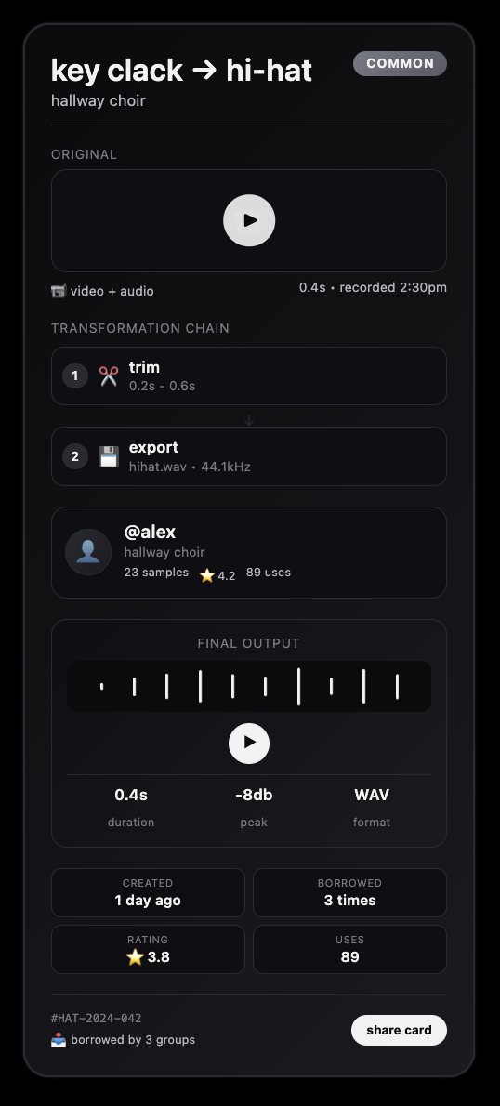
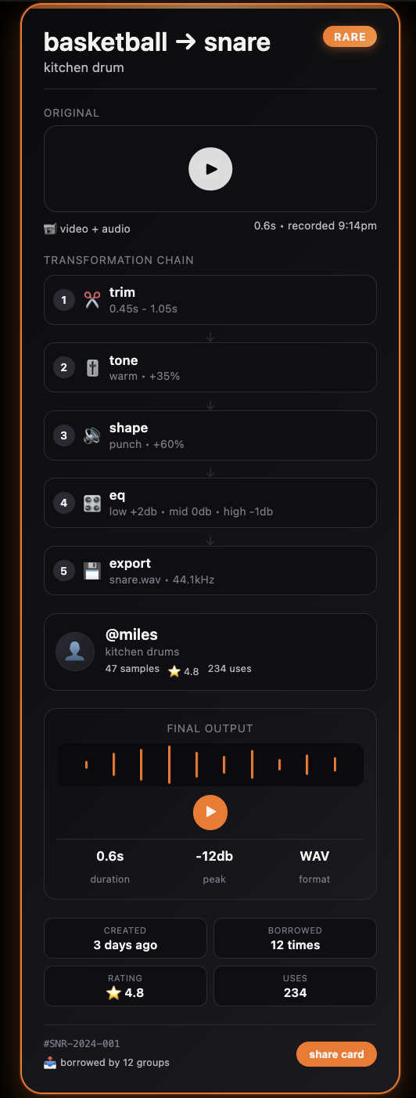
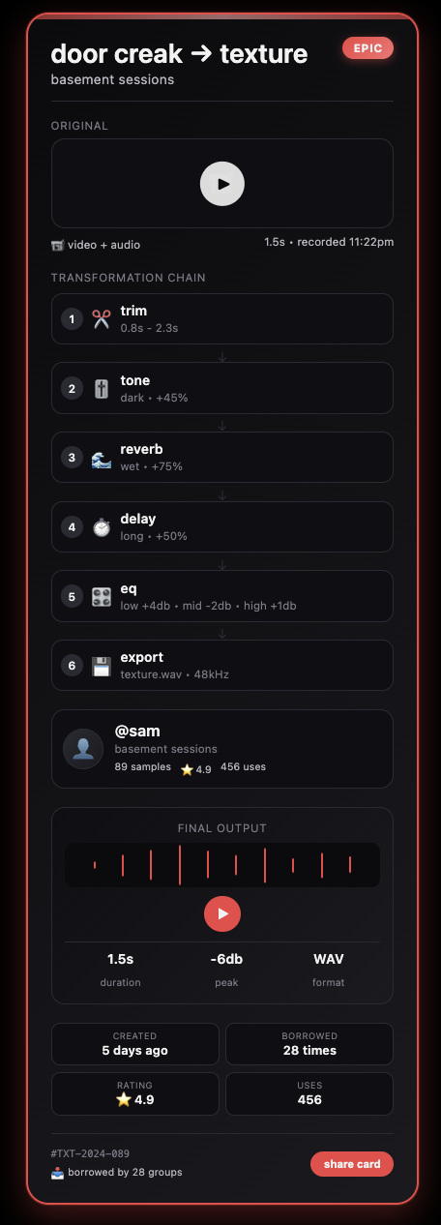
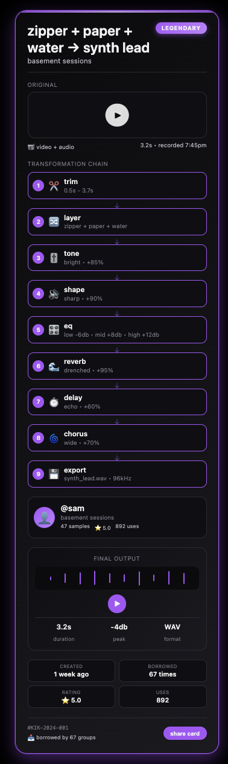

Slide 23



how is it different?
a little bit of everything
Notes:
work in UCLA anecdote about presenting

Slide 24
crowd•noise

Slide 25
thanks
Company Name
Quarter Month
Year

